Slide 1

Hackathon ENSATT
« Think the school of tomorrow »

Slide 2
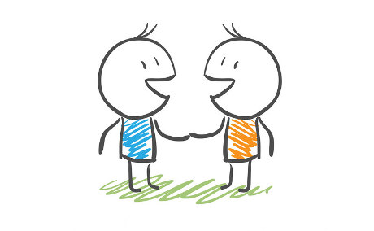
Welcome & introducing words
Team building :
Choose a challenge that speaks to you and place yourself below
Each challenge must include at least 3 different colours

Slide 3
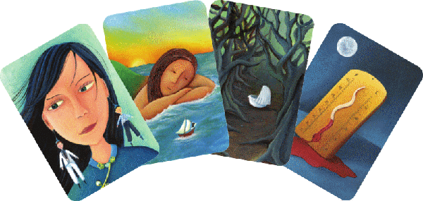
Team building
Tell your team an anecdote related to the school/teaching of the theatre that the Dixit card tells you

Slide 4
Team cohesion
As a team, you must transform as many circles as possible into recognizable objects in 3 minutes

Slide 5
State of play
1_Mental map of the situation/state of play (25 min):
based on the issue your team is dealing with
state actual facts
use color/form codes to highlight :
  positive/negative aspects,
  lacks,
  dysfunctions

Slide 6
State of play
2_Focusing time (20 min):
"Inventory of the state of play" in order to:
  Reformulate the +'s and -'s, be more or less clear with everything that has been mentioned
  Identify the major issues and formulate them into relevant questions --> 2-3 major issues to be identified
➔ Deliverable: bring out 2-3 major sub-problems that you wish to address

Slide 7
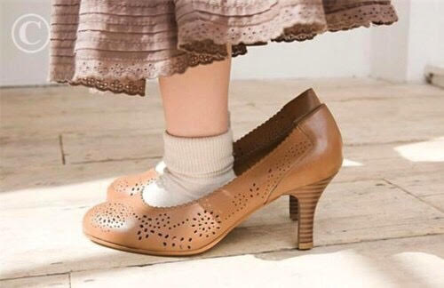

Ideation #1 : « in the shoes of »
[20 min] SOLO
choose a famous character you like/who speaks to you
put yourself in the shoes of this character
bring out as many ideas as possible on post-its to answer the sub-problem(s) chosen by your group
N.B : you can change characters if you are short of inspiration or if you want to have ideas from another angle.
Be exhaustive, bring out as many ideas as possible!
[5 min] Free exchanges / relaxation:
as a group, share the ideas that have emerged (no rendering objective)
[5 min] SOLO :
select 3 ideas you prefer among those you have brought out
➔ Deliverable : each participant must come out with 3 clear written ideas, understandable by all on post-its. Keep them with you
1 idea per post-it

Slide 8

Ideation #2
[25 min ideation time]
Each of you draws 3 columns on an A4-sheet
You’ll have 5 minutes to write and detail on your sheet the 3 ideas that you think best meet your challenge
When the 5 minutes are up, pass it on to the neighbor on the left
Then take the sheets of the neighbor on your right. You'll have 5 minutes to complete his/her ideas
At the end of these 5 minutes, pass this sheet you have just completed on to the neighbor on your left
etc. up to a full turn

Slide 9
Selection
[25 min solo selection + presentation of your ideas to the group]
Take back his or her sheet, read it again in 1 minute and select the idea that seems most relevant to you
Then explain the idea to the other members of the team
!!! TIME KEEPER !!! : 3 min presentation per idea + questions/answers
➔ Deliverable:
5 ideas (1 idea per person) placed on a flipchart
  This ideas will feed your reflection about the challenge your team choosed
  Please also keep the A4 sheets "in case" you want to use them later to develop/confirm/infirm the idea we are working on

Slide 10
Idea’s choice
From the 4/5 ideas that emerged from the last exercise, you need to proceed to develop a "global system" of ideas by :
Assembling several ideas that cross each other, are similar, complement each other, etc.
Giving the + and -, the ideas that attract the more and the less
Making connections between several ideas: mix, transpose, articulate, nourish...
➔ Deliverable: a system of ideas must emerge at the end and will be further developed on Thursday

Slide 11
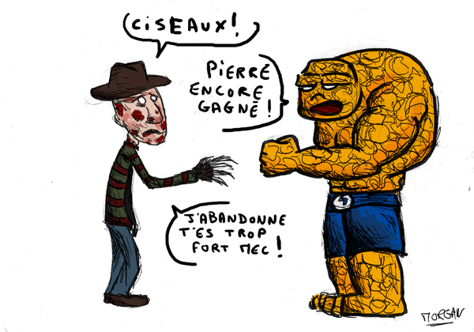

Slide 12
Get deeper into the solution
In this exercise, you will focus on deepening the solutions that emerged on Tuesday. From these solutions, you will have to think about:
  who will live them (=personas)
  how these people will live these solutions on a daily/weekly/yearly basis
  how to make the jury understand the experience that these people will be expected to live --> put the jury in a situation, think about this situation

Slide 13
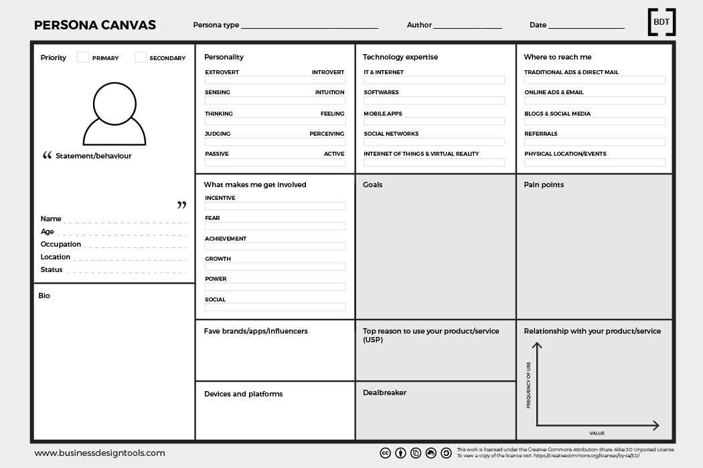

Slide 14
Get deeper into the solution
Your team has just received empty canvases to design personas
1_You will first have to imagine personas using the given canvas in order to :
  understand the people your solution is addressed to,
  their problems,
  their needs,
  what they expect,
  how they see their environment, etc.
2_ imagine route(s) that will describe:
  one typical day / week / year depending on the chosen solution and the simulation that your concept will require
  interactions with other people
  the person's evolution as they live this experience, etc.
+ give operational answers (cf. specifications: time, approx. budget, manpower...).
The more the story is told, the more the jury understands and is empathetic. Again : the person who discovers the solution starts from scratch !

Slide 15
Overall design of the islet experience
Deliverable : 1 mini-folder including:
1 sheet with the concept in a few lines
4 technical data sheets/ specifications with sound/multimedia/light/design needs to be distributed to technicians

Slide 16
Feasibility study
Sound
Multimedia
Lighting
Stock/design
Etc.
1 or 2 people per team who speaks French go to the technicians in the living lab to make their technical requests and present the technical sheets.
The other members of the team continue to work on the persona and the path + imagination of the islet

Slide 17
Free work until 15:00 !!! ➔ NO GLOBAL TIME KEEPING
Break, lunch break in the lunch room at 12:15
Global rehearsal at 15:00
Jury time at 15:30

